Slide 1

What is
Git & GitHub?
Icons made by Freepik from www.flaticon.com

Slide 2
Lessons' Objective
For everyone to…
1
Understand what is Git and GitHub
2
Successfully manage their code projects with Git and GitHub

Slide 3


Overview
What is Git?
What is GitHub?
Hands-On Sections
Install Git
Create GitHub account
Start a repository
GitHub Icon
GitHub Icon

Slide 4
What is Git?
What is Git?

Slide 5
First, What is Version Control?
What is Git?
History - Keeps track of all the changes made to the files over time
Teamwork - Allows for multiple people working on the same project at the same time
Backup - Allows for easy file and folder recovery
Game Checkpoint
Notes:
Similar to a game's checkpoint system.
You save your current status of the game so if you were to miss up in the next level,
you do not start all over but simply go back to where you last saved your spot.

Slide 6
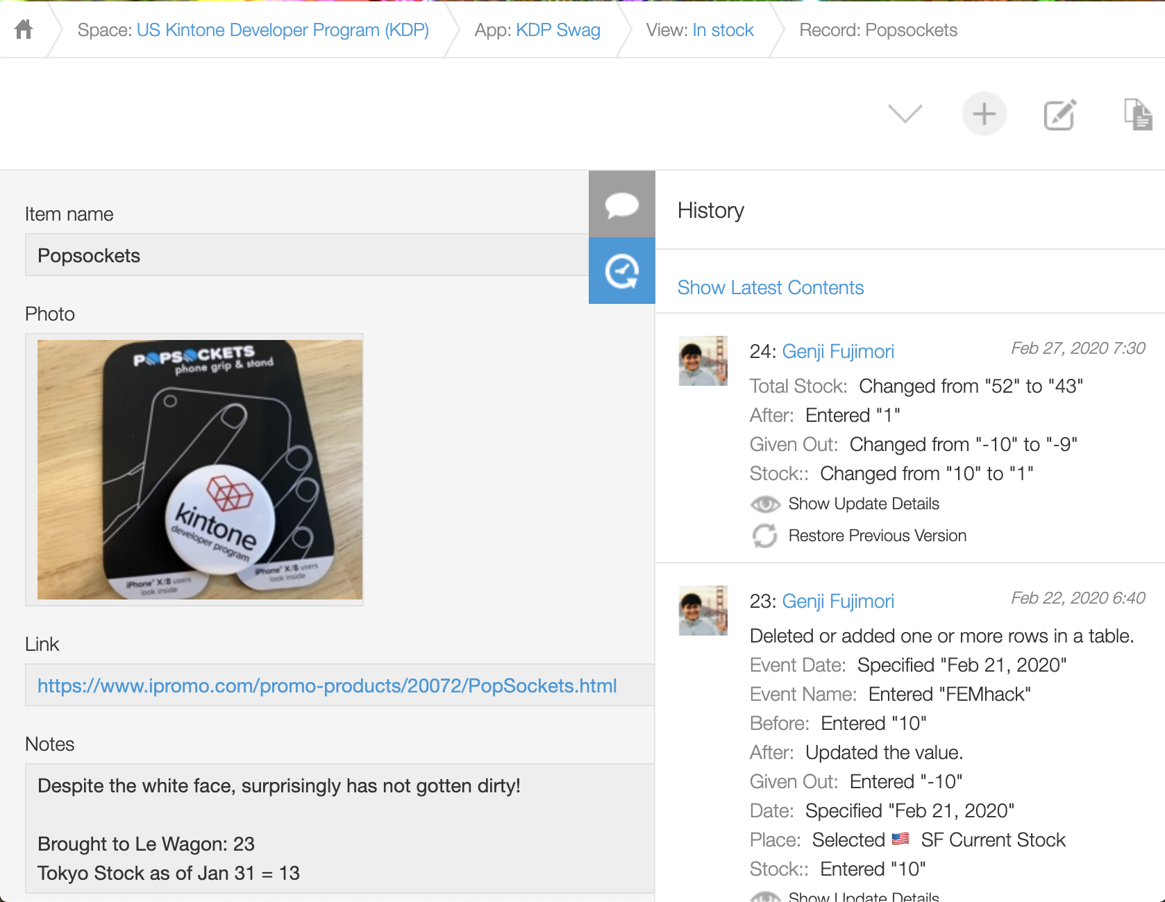
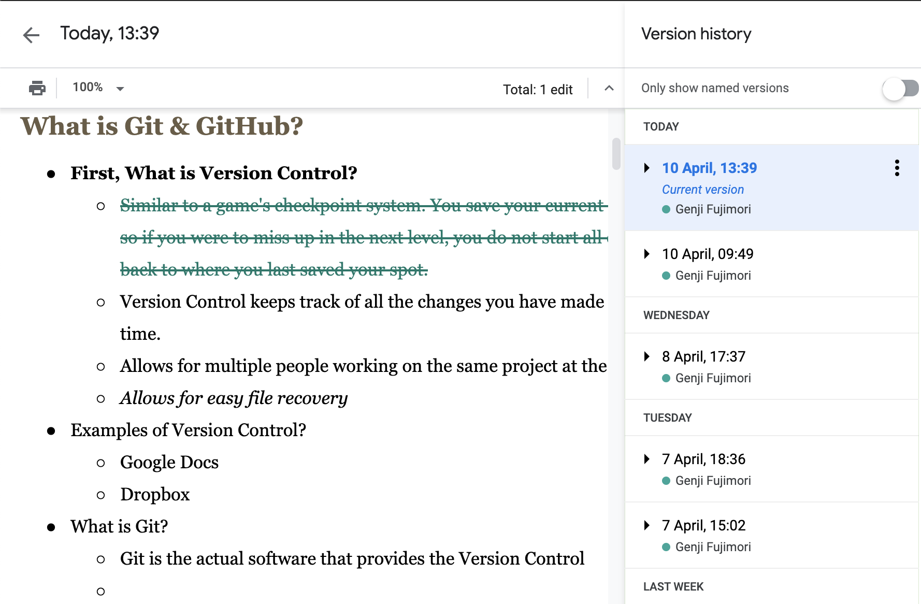
Version Control Examples
Git
Google Docs
Kintone
Notes:
Similar to a game's checkpoint system.
You save your current status of the game so if you were to miss up in the next level,
you do not start all over but simply go back to where you last saved your spot.

Slide 7
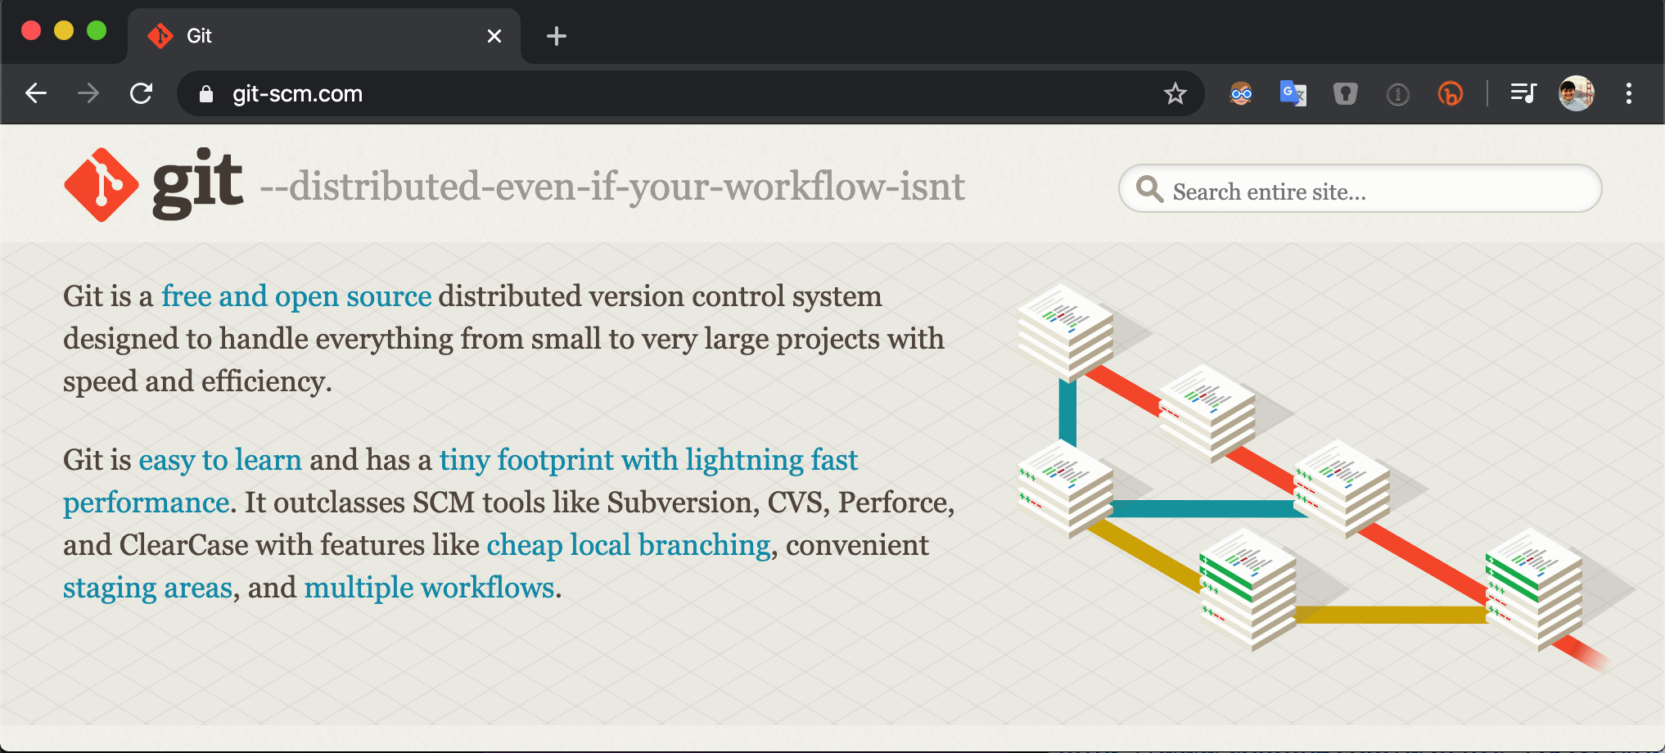
Git is…
Git
Git is the actual software that provides the version control to manage software development
Started in 2005 as a tool to manage Linux kernel development
Free & open-source distributed version control system

Slide 8
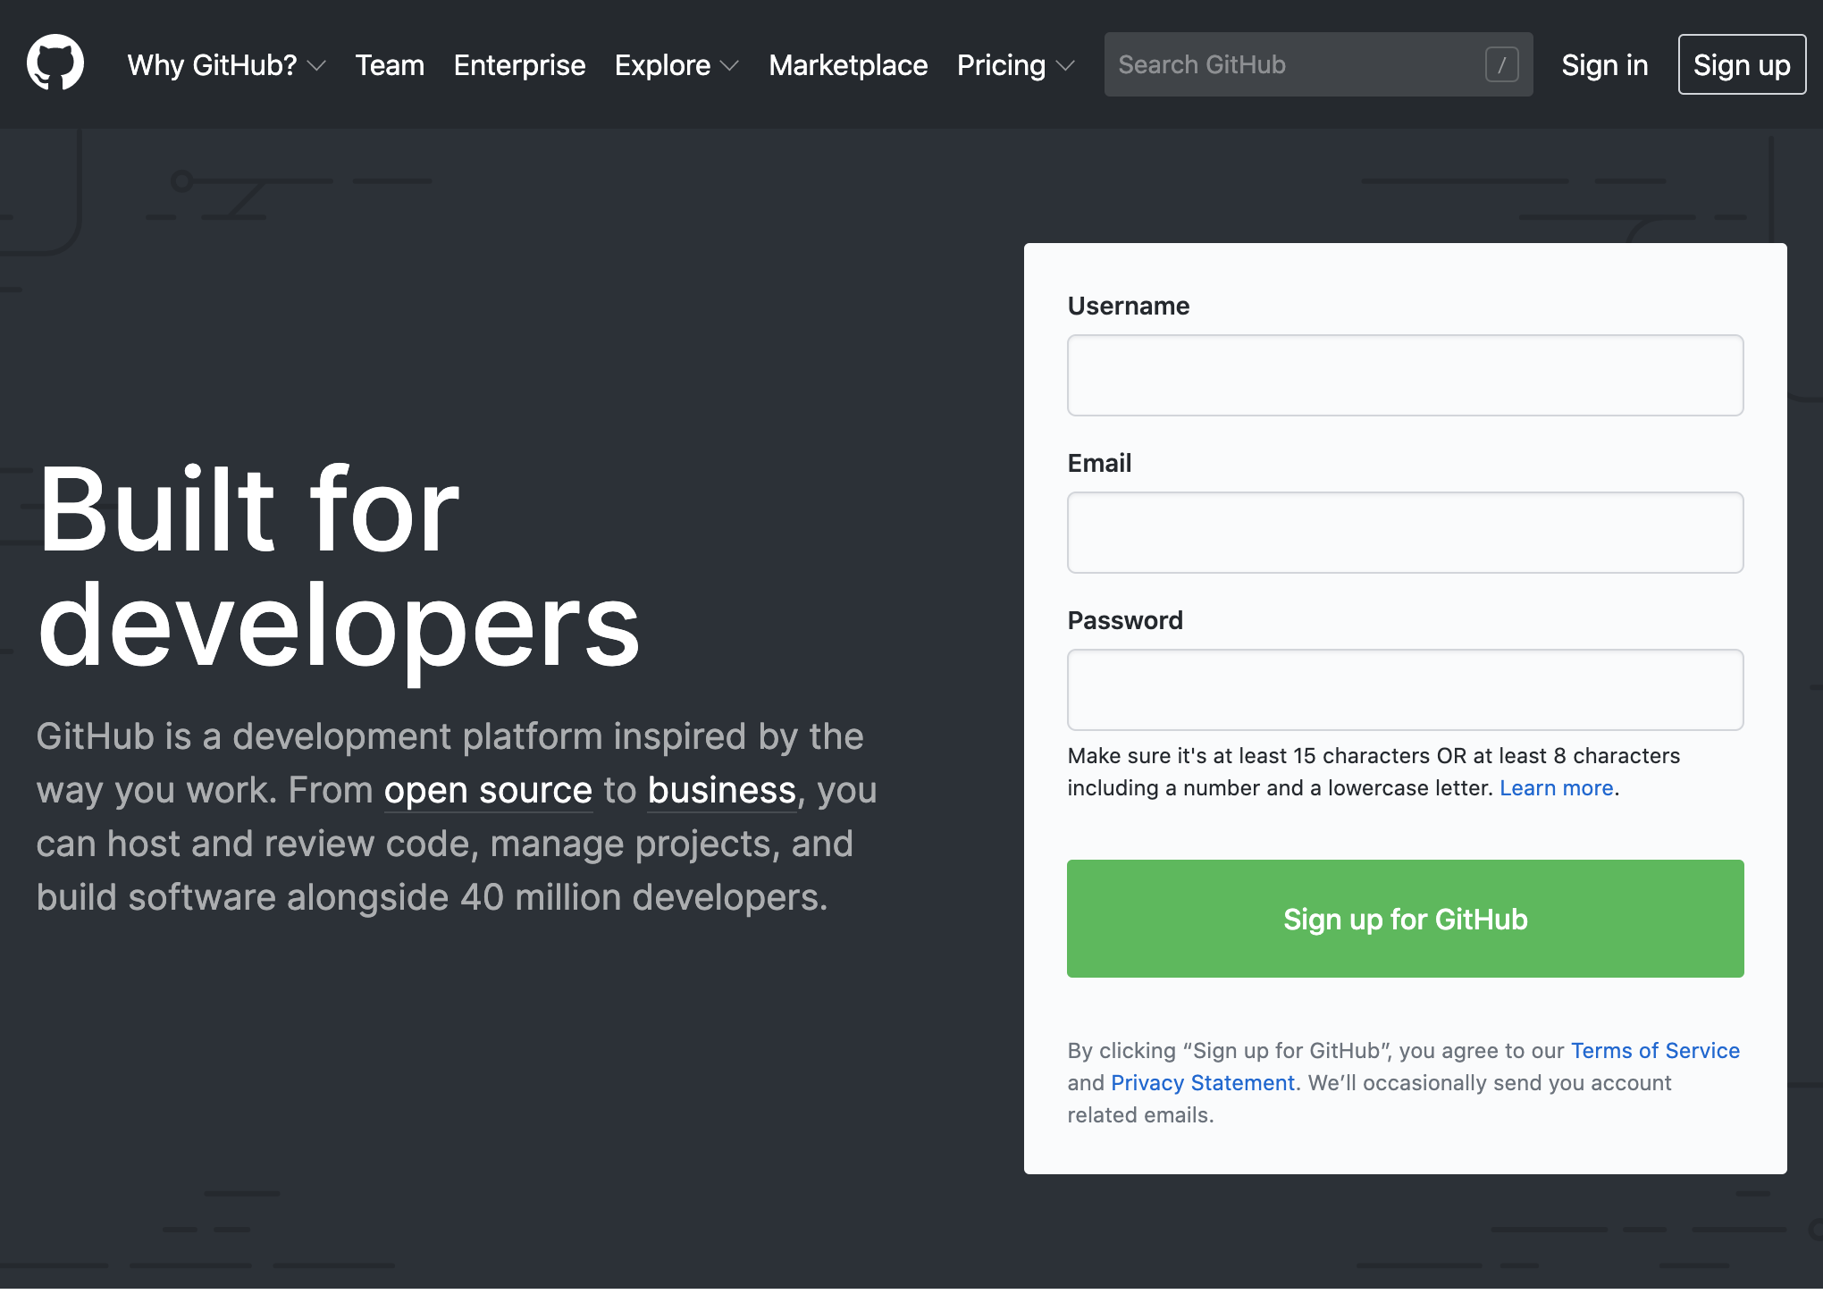
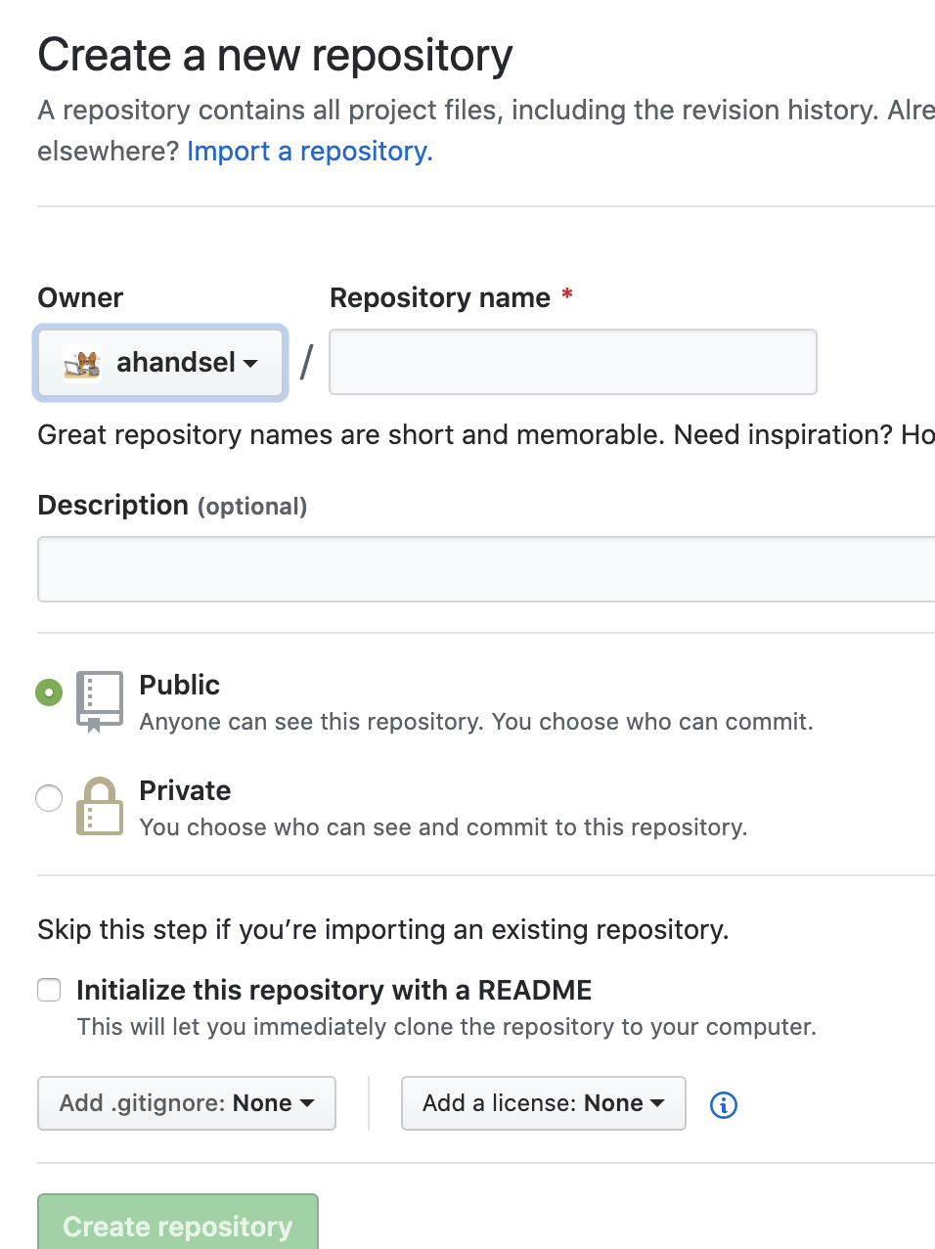
GitHub is…
GitHub
GitHub.com is a collaboration platform
Web-based git repository hosting service.
i.e. hosts the 'remote repositories'
Founded in 2008 and now a Microsoft subsidiary

Slide 9
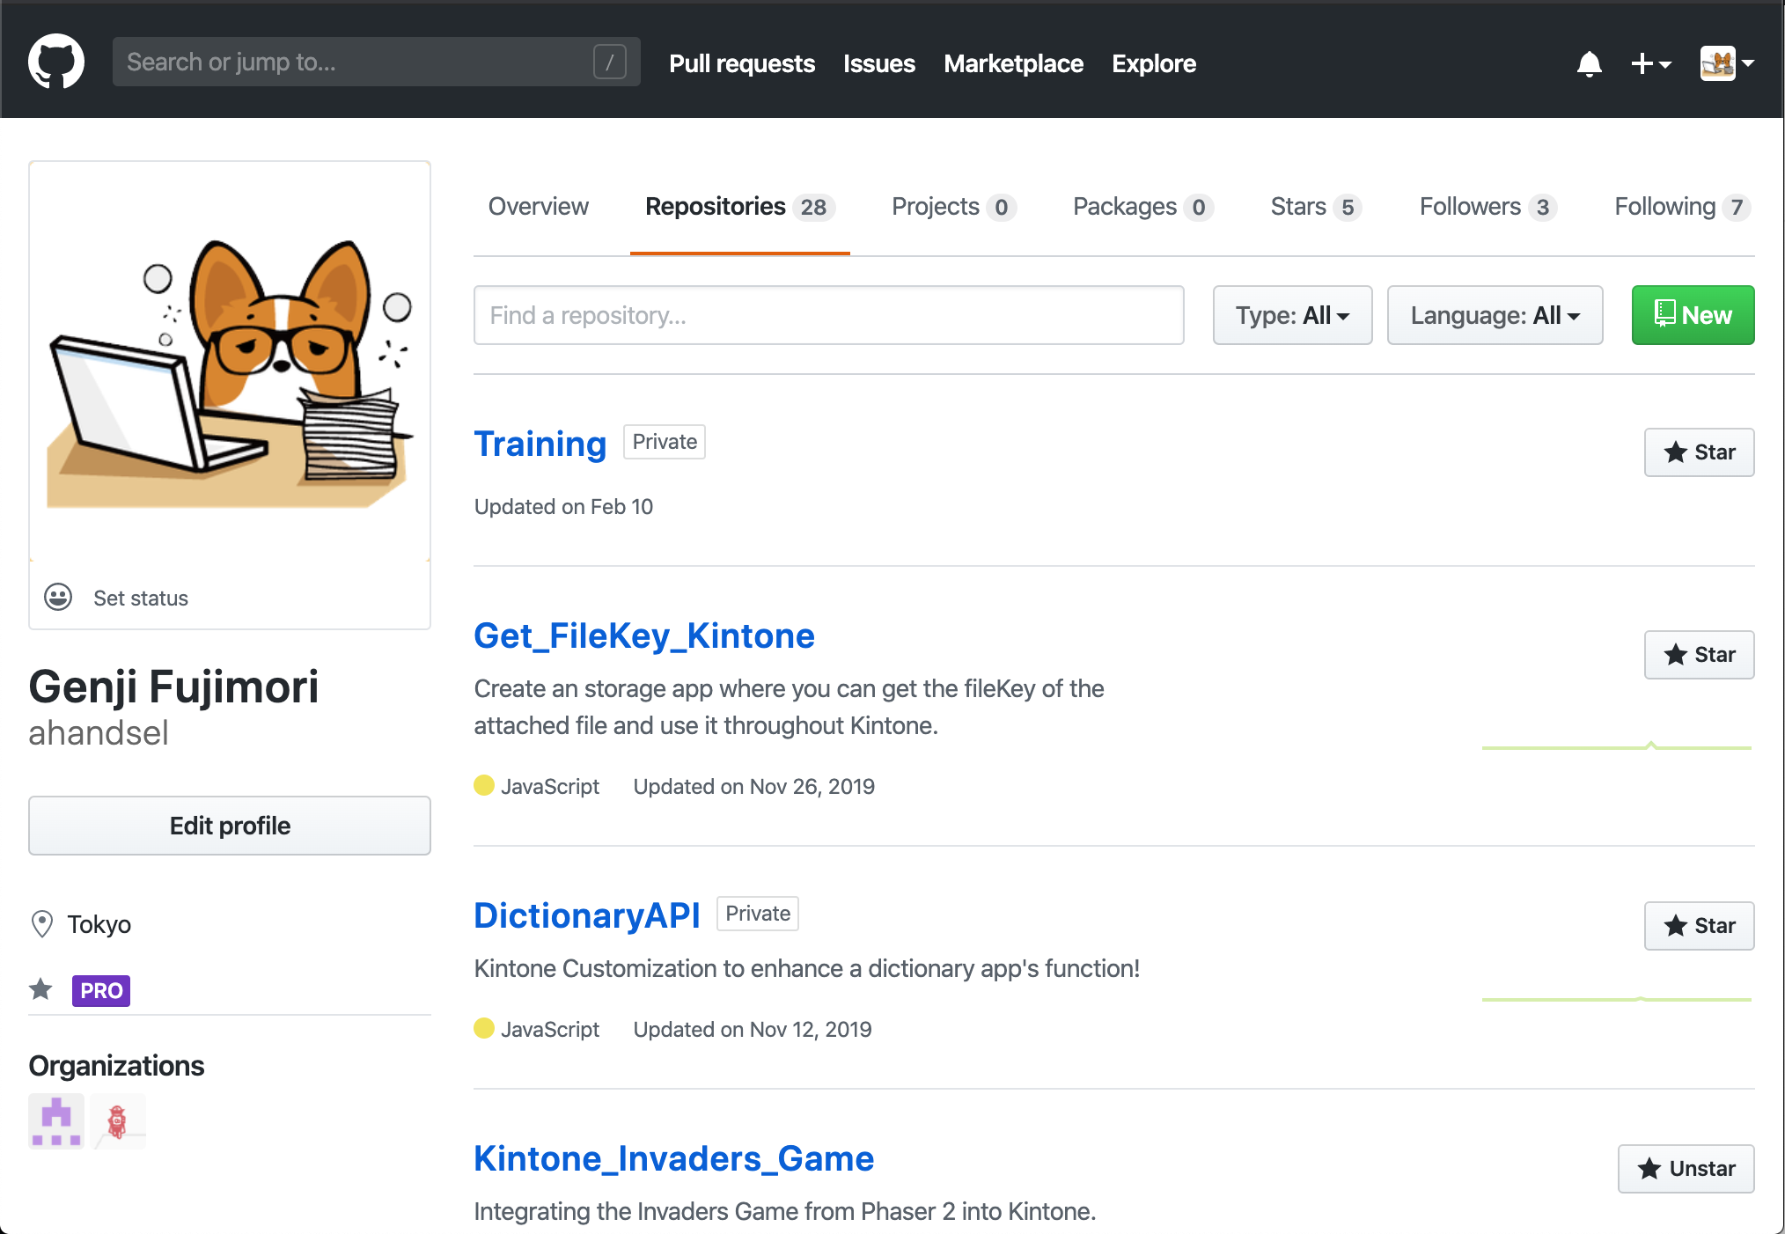
Create a GitHub Account
Installation
Create a GitHub account → github.com
Add 2-Factor Authentication (help doc)
Go to GitHub Settings:
Profile Photo > Settings > Security > Two-factor authentication
https://github.com/settings/security
Install an Authenticator App:
e.g. Microsoft, Authy, Enpass

Slide 10
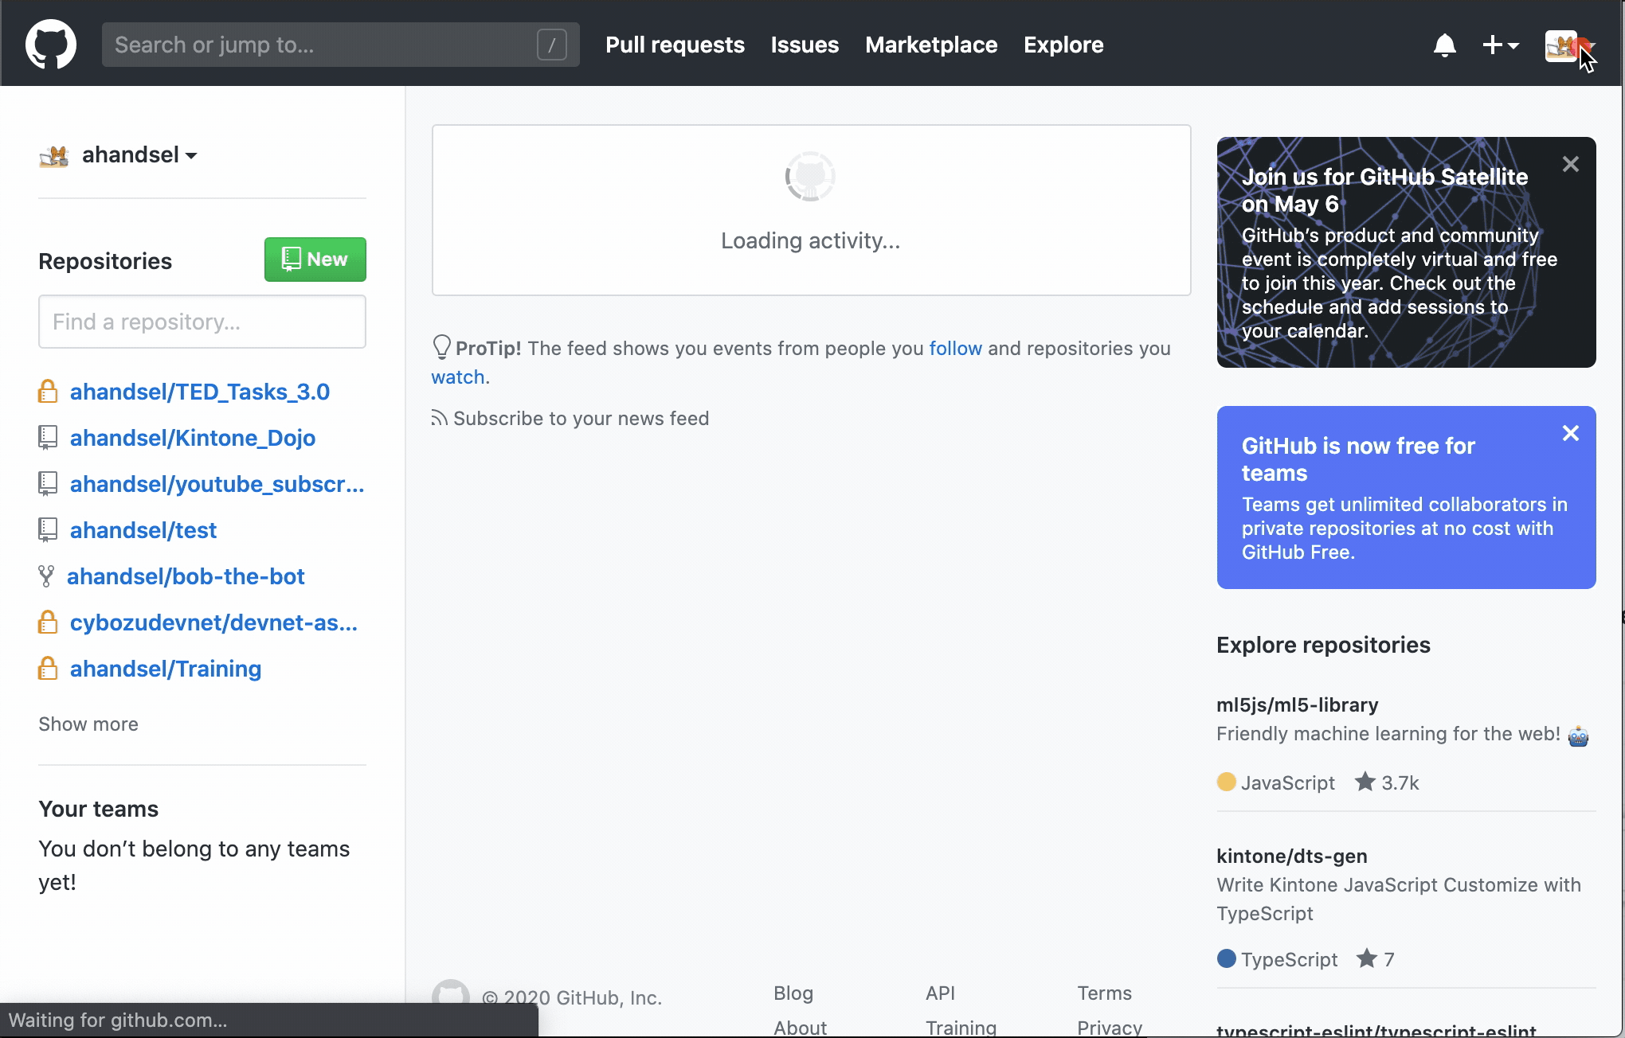
Personal Access Token for Command Line
Installation
Generate a Personal Access Tokens
Settings > Developer settings > Personal access tokens
https://github.com/settings/tokens/new
Use this token when accessing your GitHub account via Terminal
Use Tokens instead of passwords.
Generate a token per use-case.
https://help.github.com/en/github/authenticating-to-github/creating-a-personal-access-token-for-the-command-line
Notes:
https://help.github.com/en/github/authenticating-to-github/creating-a-personal-access-token-for-the-command-line

Slide 11
MacOS
Installation
Hands-on Part A

Slide 12
Install Git - MacOS
Installation
Do you have Homebrew?
If not, install Homebrew first:
If so, be sure to upgrade it:
Install git with Homebrew:
Confirm installation:
Expected result:
$ brew install git
https://brew.sh/
$ git --version
$ brew update && brew upgrade
git version 2.26.2
https://git-scm.com/book/en/v2/Getting-Started-Installing-Git
Notes:
https://git-scm.com/book/en/v2/Getting-Started-Installing-Git

Slide 13
Install Git - MacOS - Potential Issue
Installation
If you get the following result:
Try:
Or try:
git version 1.7.10.2 (Apple Git-33)
$ brew link --force git
export PATH=/usr/local/bin:$PATH

Slide 14
Windows
Installation
Hands-on Part A

Slide 15
Installing Git on Windows
#1 Install Windows Subsystem for Linux (WSL)
#2 Configure WSL
#3 Configure Git
Ubuntu 18.04 LTS
github.com/hangxingliu/wslgit
git clone git@github.com:user/a.git

Slide 16
WSL's Required Environment
WSL
Start button
> Settings
> Update & Security
> Windows Update
Be sure to update your Windows OS
Must be Windows 10 Version 1709 (OS build 16299) or later!

Slide 17
Install Windows Subsystem for Linux (WSL)
WSL
Enable-WindowsOptionalFeature -Online -FeatureName Microsoft-Windows-Subsystem-Linux
Enable "Windows Subsystem for Linux" optional feature
Open PowerShell as Administrator and run the command
Restart your computer when prompted.
Notes:
https://docs.microsoft.com/en-us/windows/wsl/install-win10#complete-initialization-of-your-distro
https://docs.microsoft.com/ja-jp/windows/wsl/install-win10

Slide 18
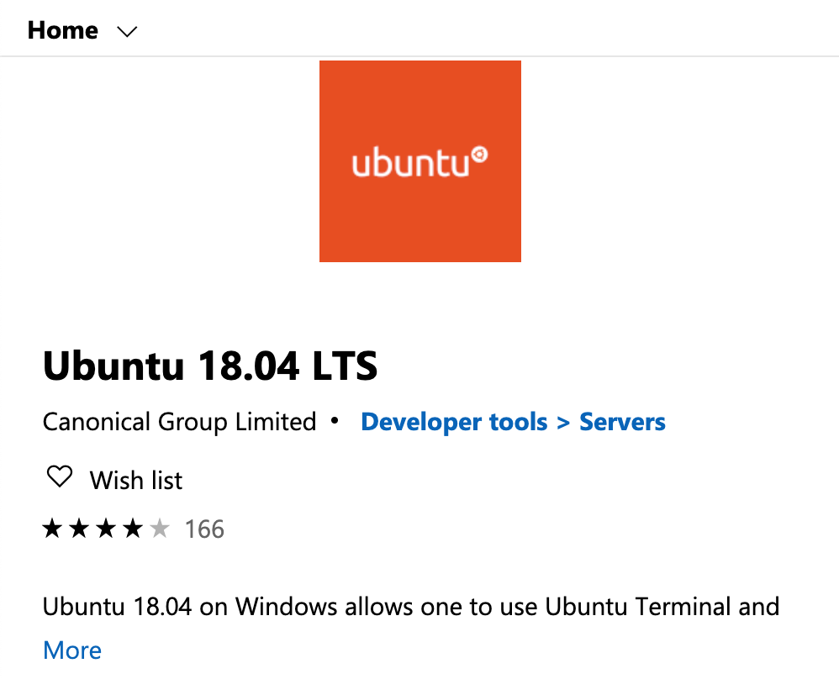
Install Windows Subsystem for Linux (WSL)
WSL
Install your Linux Distribution of Choice
Download and install from the Microsoft Store (see below)
Ubuntu 18.04 LTS
microsoft.com/store/apps/9N9TNGVNDL3Q
Notes:
https://docs.microsoft.com/en-us/windows/wsl/install-win10#complete-initialization-of-your-distro
https://docs.microsoft.com/ja-jp/windows/wsl/install-win10

Slide 19
Configure WSL - Initialize
WSL
, this may take a few minutes...
Please create a default UNIX user account. The username does not need to match your Windows username.
For more information visit: https://aka.ms/wslusers
Enter new UNIX username: panda
Enter new UNIX password:
Retype new UNIX password:
passwd: password updated successfully
Installation successful!
To run a command as administrator (user "root"), use "sudo <command>".
See "man sudo_root" for details.
Launch the distro (Ubuntu 18.04)
Click the launch button in the Microsoft Store App
Setting up a new Linux user account
This user account will not impact your Windows username
The password is needed when running sudo commands
Notes:
https://docs.microsoft.com/en-us/windows/wsl/initialize-distro
https://docs.microsoft.com/ja-jp/windows/wsl/initialize-distro

Slide 20
Configure WSL - Initialize
WSL + Git
Update & upgrade your distro's packages
Enter Y when asked "Do you want to continue? [Y/n]"
Install git
sudo apt update && sudo apt upgrade
sudo apt install git
Notes:
https://docs.microsoft.com/en-us/windows/wsl/initialize-distro
https://docs.microsoft.com/ja-jp/windows/wsl/initialize-distro

Slide 21
Configure WSL - Initialize
WSL + Git
Download the wslgit repository
tool to forward all requests for git to WSL
Go inside the wslgit folder
Move the wslgit.sh file to the WSL executable location in /usr/bin
Get back to home folder
$ git clone https://github.com/hangxingliu/wslgit
$ cd wslgit/
$ sudo mv wslgit.sh /usr/bin/wslgit.sh
$ cd

Slide 22
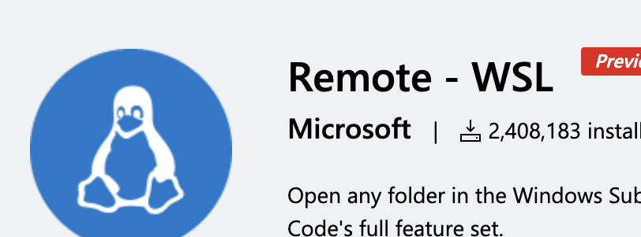
Configure WSL - VS Code
WSL + Git + VS Code
Download Remote - WSL VS Code Extension
https://marketplace.visualstudio.com/items?itemName=ms-vscode-remote.remote-wsl
Go to VS Code Settings to change the git.path object:
{
"git.path": "C:\Users\Please\AppData\Local\Packages\CanonicalGroupLimited.Ubuntu18.04onWindows_79rhkp1fndgsc\LocalState\rootfs\home\panda\wslgit\git.bat"
}
Notes:
https://git-scm.com/book/en/v2/Getting-Started-Installing-Git

Slide 23
Japanese version of Ubuntu
JP + Ubuntu
sudo apt -y install language-pack-ja
sudo update-locale LANG=ja_JP.UTF8
sudo apt -y install manpages-ja manpages-ja-dev
Install the Japanese language pack
Set local language to Japanese
Restart Ubuntu
Install Japanese manuals
Notes:
https://qiita.com/asazuke/items/f8eff69bce0bee083fcf#writing_hand_tone2wsl%E7%92%B0%E5%A2%83%E6%A7%8B%E7%AF%89%E5%80%8B%E4%BA%BA%E7%9A%84%E3%83%A1%E3%83%A2writing_hand_tone2

Slide 24
Configure Git + GitHub
Git + GitHub
$ ssh-keygen
Generating public/private rsa key pair.
Enter file in which to save the key (/home/user/.ssh/id_rsa):
Created directory '/home/user/.ssh'.
Enter passphrase (empty for no passphrase):
Enter same passphrase again:
Your identification has been saved in /home/user/.ssh/id_rsa.
Your public key has been saved in /home/user/.ssh/id_rsa.pub.
…
Generate an SSH key
It is required to link with GitHub
Leave the questions blank and just ENTER

Slide 25
Configure Git + GitHub
Git + GitHub
Copy the key to the clipboard
This is needed to be pasted into GitHub.com's setting page.
cat ~/.ssh/id_rsa.pub | clip.exe

Slide 26
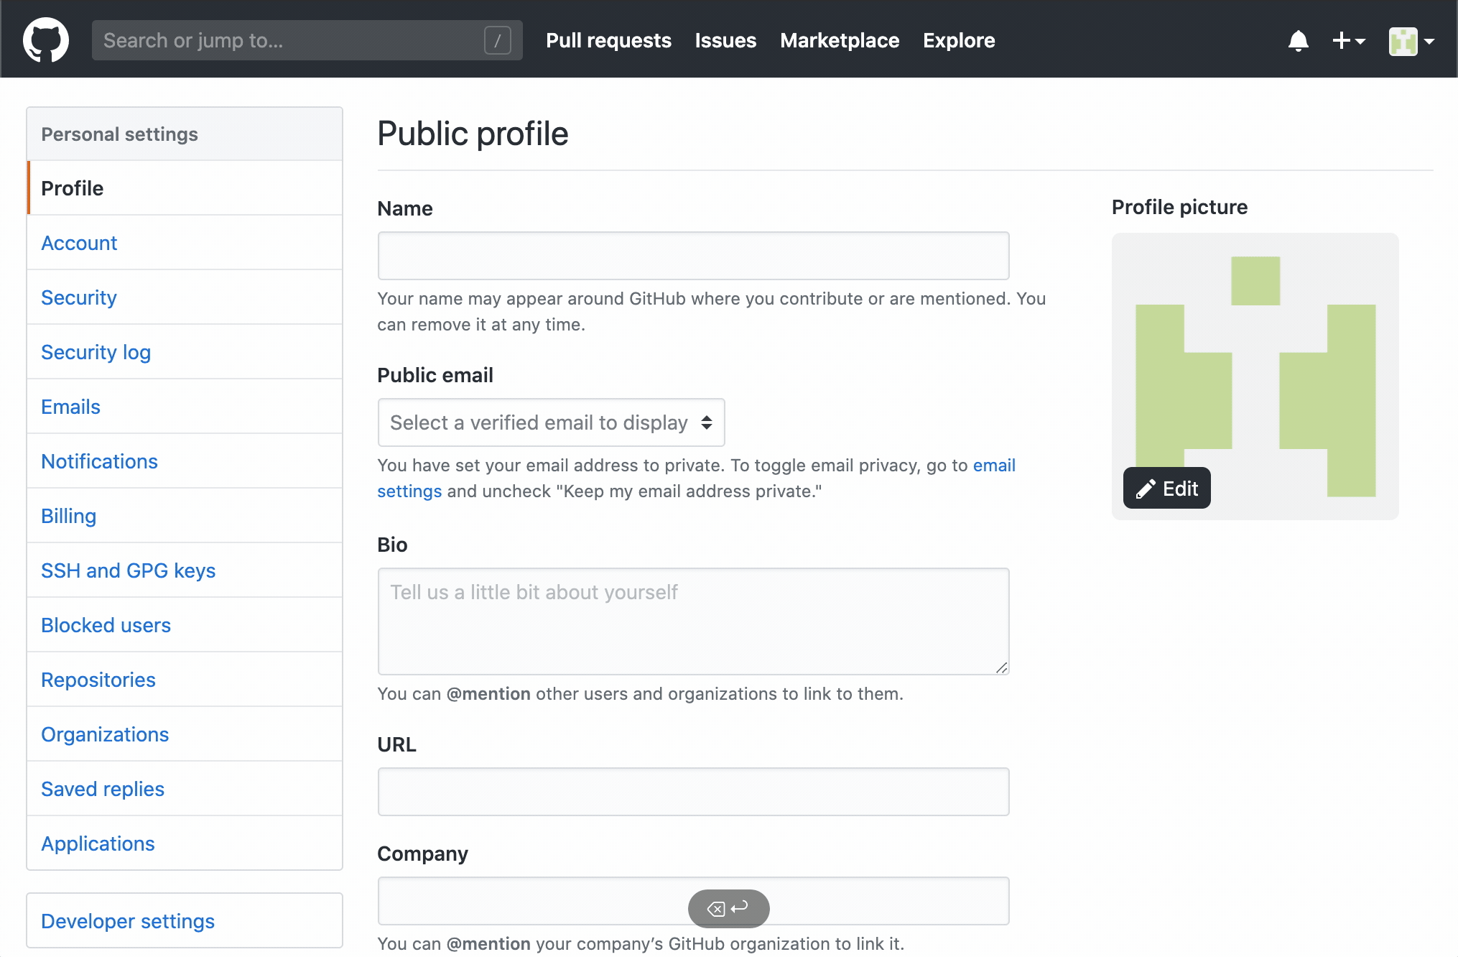
Configure Git + GitHub
Git + GitHub
GitHub.com/settings
> SSH and GPG Keys
> click New SSH key button
Type Windows WSL for Title
Paste the public key
> click Add SSH key button

Slide 27
Confirm the Settings
Git + GitHub
Confirm the settings with the following commands
$ ssh -T git@github.com
The authenticity of host 'github.com (13.114.40.48)' can't be established.
RSA key fingerprint is SHA256:xxx.
Are you sure you want to continue connecting (yes/no)? yes
Warning: Permanently added 'github.com,13.114.40.48' (RSA) to the list of known hosts.
Hi ahandsel! You've successfully authenticated, but GitHub does not provide shell access.

Slide 28
VS Code + Explorer
WSL
To open the Explorer from the current Linux folder, enter:
To open the VS Code from the current Linux folder, enter:
explorer.exe .
code .
Notes:
https://docs.microsoft.com/en-us/windows/wsl/initialize-distro
https://docs.microsoft.com/ja-jp/windows/wsl/initialize-distro

Slide 29
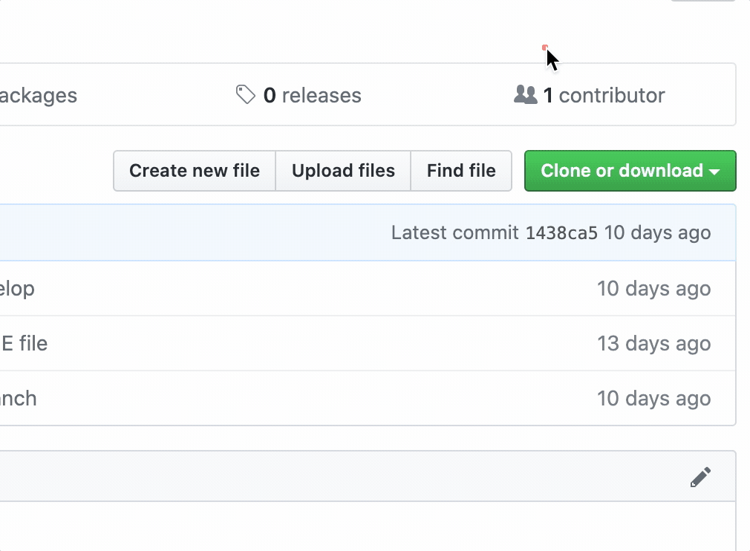
Windows + WLS and GitHub
WSL + GitHub
Instead of using HTTPS → Use SSH
git clone https://github.com/.../a.git
git clone git@github.com:.../a.git

Slide 30
Getting Started
Hands-on B

Slide 31
Configure Git
Getting Started
Configure your Git username and email with git config
For Mac, use Terminal
For Windows, use PowerShell or Git Bash
$ git config --global user.name "GitHub_UserName"
$ git config --global user.email "example@email.com"
$ git config --global color.ui auto
$ git config --global --list
https://git-scm.com/book/en/v2/Getting-Started-First-Time-Git-Setup
Notes:
https://git-scm.com/book/en/v2/Customizing-Git-Git-Configuration
https://git-scm.com/book/en/v2/Getting-Started-First-Time-Git-Setup

Slide 32
Create a Local Git Repository
Getting Started
$ cd Documents
$ mkdir kintone_dojo
$ cd kintone_dojo
$ git init
Initialized empty Git repository in /Users/g001494/Documents/Kintone_Dojo/.git/
In your terminal, go to Documents and create a directory named kintone_dojo
$ pwd ~/Documents/kintone_dojo
In there, initialize a git repository
Repository is often shortened to Repo

Slide 33
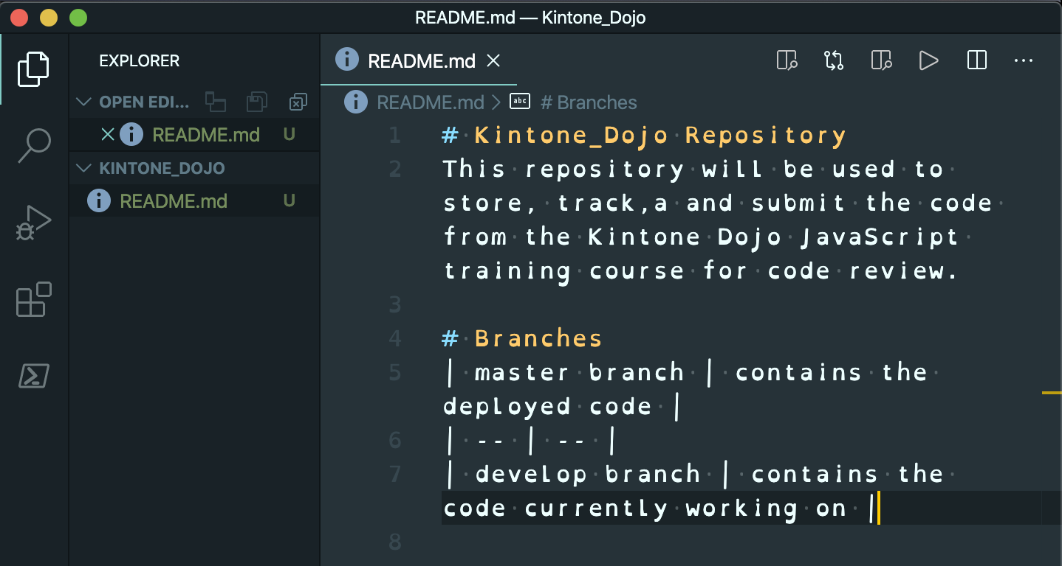
Add a README.md file to the Local Repo
Getting Started
$ touch README.md
$ code .
Create a README.md file
Open the current kintone_dojo directory with VS Code
See appendix for setup
Add a description of your repository in the markdown file

Slide 34
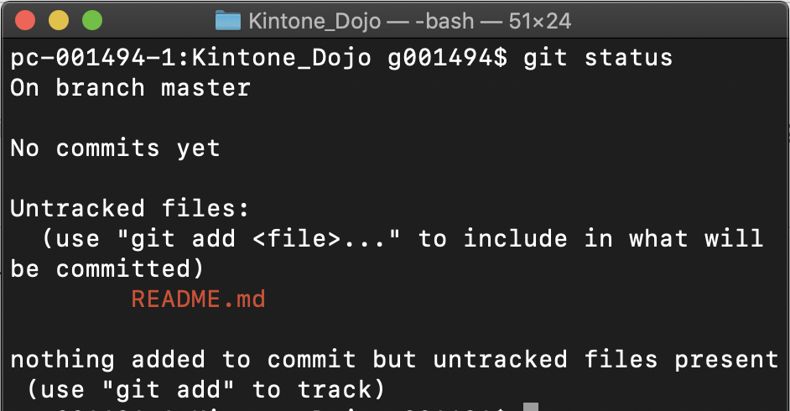
Check Git's Status
Getting Started
$ git status
git status
command that shows the working directory's & staging area's state
Changes to be committed: You can see which changes have & have not been staged
Untracked files: You can see which files are not being tracked by git
See that the README.md needs to be tracked by git
Notes:
https://git-scm.com/docs/git-status
https://www.atlassian.com/git/tutorials/inspecting-a-repository

Slide 35
Saving #1 - Add a File to Git's Staging Area
Getting Started
$ git add README.md
$ git status
On branch master
No commits yet
Changes to be committed:
(use "git rm --cached <file>…" to unstage)
new file: README.md
git add [file/folder]
command to add the [file/folder] to the staging area
Now the README.md is now in staging area
Notes:
https://git-scm.com/docs/git-add

Slide 36
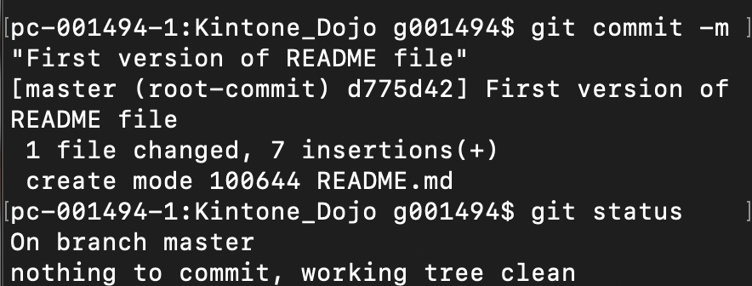
Saving #2 - Add a File to Git Repo
Getting Started
git commit -m "message"
command to add the file/folder to the repository
Now the README.md is now in the repository
specifically the master branch
$ git commit -m "First version of README file"
$ git status
Notes:
https://git-scm.com/docs/git-commit

Slide 37
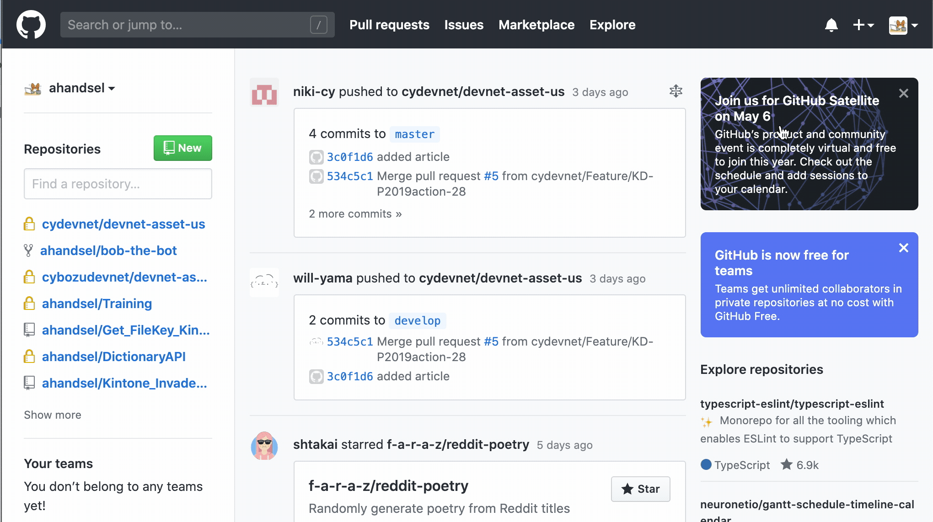
Create a GitHub Repository
Getting Started
Create a Repository
https://github.com/new
Name your repository kintone_dojo
Do not initialize repository with README

Slide 38
Local Git → GitHub
Getting Started
Push the existing repository!
Get the URL by clicking on Clone or download button & copying the HTTPS link
git remote add origin <link>
connects the git managed local repository with GitHub's remote
git remote
command to manage the remote repos
Notes:
https://help.github.com/en/github/using-git/adding-a-remote
https://git-scm.com/docs/git-remote
https://git-scm.com/docs/git-push

Slide 39
Local Git → GitHub
$ git remote add origin https://github.com/ahandsel/kintone_dojo.git
$ git push -u origin master
Username for 'github.com': ahandsel
Password for 'ahandsel@github.com': <Token_Here>
Counting objects: 100% (3/3), done.
Delta compression using up to 4 threads
Compressing objects: 100% (2/2), done.
Writing objects: 100% (3/3), 434 bytes | 86.00 KiB/s, done.
Total 3 (delta 0), reused 0 (delta 0), pack-reused 0
To https://github.com/ahandsel/kintone_dojo.git
* [new branch] master -> master
Branch 'master' set up to track remote branch 'master' from 'origin'.

Slide 40
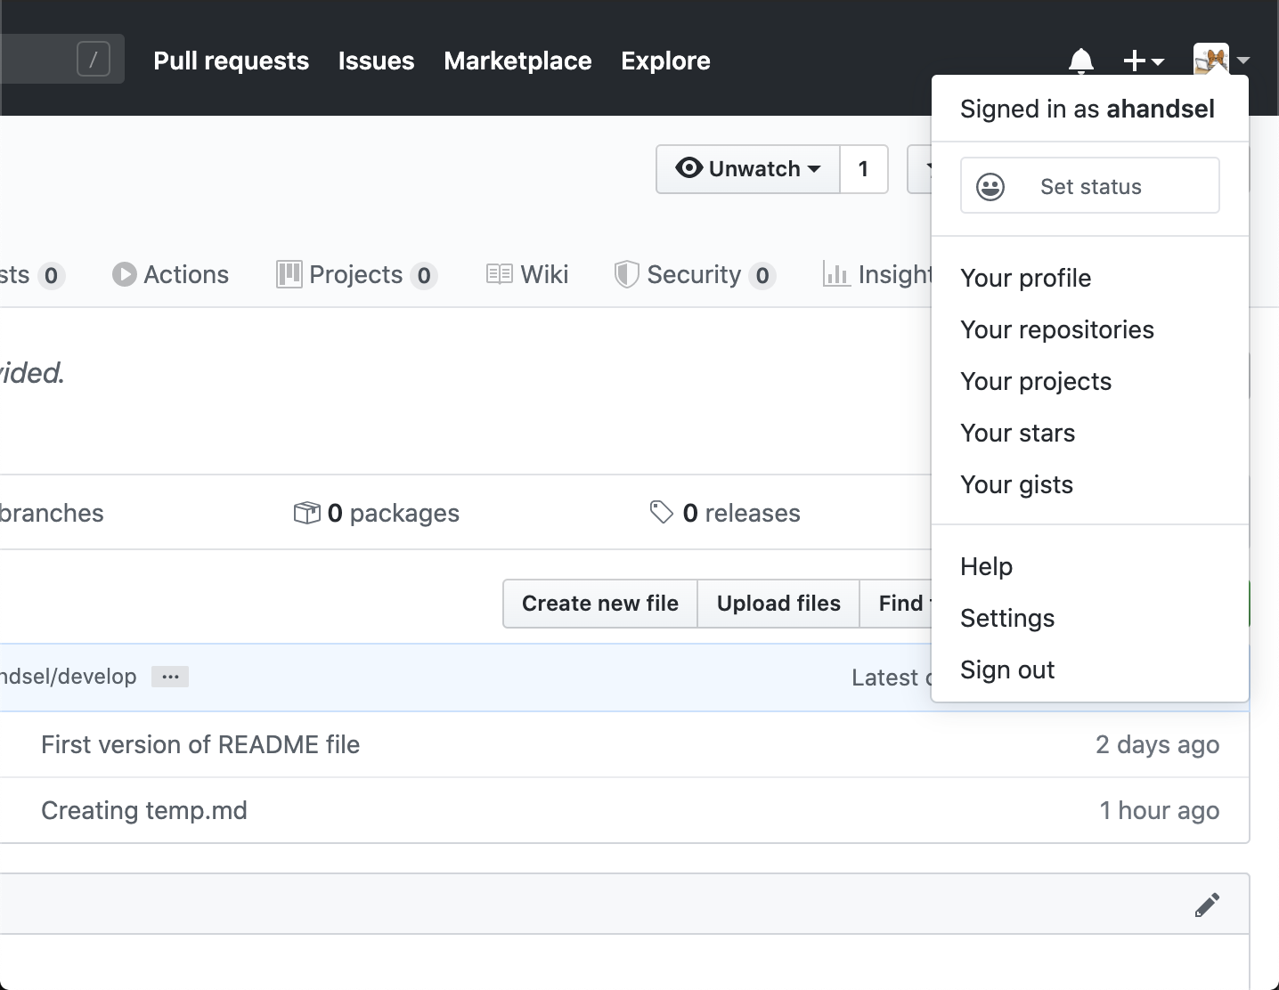
Congrats! Hands-on A & B is Completed!
Install & Configure git on PC
Create & Configure GitHub
Create & push a local repository
$ git config
--global
user.name
user.email
--list
$ git init
$ git status
$ git commit -m

Slide 41
Saving with Git and Remote Repos
Overview of Hands-on B

Slide 42
Saving Changes with Git
Saving with Git
There are 2 commands to transfer the items between the "locations"
working directory
There are 3 "locations" where files, folders, and changes are stored
git add
staging area
git commit
repository
https://git-scm.com/

Slide 43
Saving Changes with Git
Saving with Git
working directory
the current local directory that you are working on.
all changes first takes place here
git add
command that promotes a change from working directory to staging area
working directory
git add
staging area
git commit
repository
Notes:
https://git-scm.com/
https://dev.to/sublimegeek/git-staging-area-explained-like-im-five-1anh

Slide 44
Saving Changes with Git
Saving with Git
staging area
the buffer between the working directory & the repository
used to be called the 'index'
the promoted changes are bundled together, waiting for the next commit
working directory
git add
staging area
git commit
repository
Notes:
https://git-scm.com/
https://dev.to/sublimegeek/git-staging-area-explained-like-im-five-1anh

Slide 45
Saving Changes with Git
Saving with Git
git commit
command to record changes to the repository
used once all the files with the changes you want to be saved are in staging area
Game Check-In
it is like when you defeated the boss & want to save your progress in the game
comments per commit provides a natural documentation
working directory
git add
staging area
git commit
repository
Notes:
https://git-scm.com/
https://dev.to/sublimegeek/git-staging-area-explained-like-im-five-1anh

Slide 46
Saving Changes with Git
Saving with Git
repository
git repository is the actual ".git" folder inside a project
the folder tracks all the changes made in the project
i.e. the historian
remote repository (GitHub)
the repository on GitHub's server, allowing the code to be viewed by others
working directory
git add
staging area
git commit
repository
Notes:
https://git-scm.com/
https://dev.to/sublimegeek/git-staging-area-explained-like-im-five-1anh

Slide 47
Why have Staging Area?
Saving with Git
To stage a file = prepare the file for a commit
You can add and remove files that pertains to a specific commit you want to make.
Example Situation:
You are working on 2 features.
Feature A is done but feature B needs more work.
You need to commit your code before going home.
Solution: Add feature A related files to the staging area & commit.
Result: Feature A is committed and viewable to others while feature B is still in your working directory (un-staged).

Slide 48
Working with Remote Repos
Remote Repos
$ git remote -verbose
origin https://github.com/user/repo (fetch)
origin https://github.com /user/repo (push)
git remote command
manages the connection between your local & remote repositories
git remote --verbose
lists out the URLs that Git has stored & alias (nickname) that can be used when reading & writing to that remote repo
Notes:
https://git-scm.com/book/en/v2/Git-Basics-Working-with-Remotes
https://git-scm.com/docs/git-remote

Slide 49
Working with Remote Repos
Remote Repos
git remote add origin <link>
git creates an alias of the remote repository when you clone a remote repository to your local machine
i.e. nickname is assigned per remote repository's URL
Most common alias is called "origin."
Thus, both following commands does the same thing:
git push -u https://github.com/user/repo.git master
git remote add ALIAS https://github.com/ahandsel/repo.git
git push -u ALIAS master
Notes:
https://git-scm.com/book/en/v2/Git-Basics-Working-with-Remotes
https://git-scm.com/docs/git-remote

Slide 50
git push?
Remote Repos
git push [remote] [branch]
command to upload local repo content to a remote repo
i.e. export the commits from your local → remote repo
counterpart to git fetch (import commits to local repo)
Note: Pushing can potentially overwrite changes!
git push command works only for remote repo that has not been modified since your last push or clone
i.e. No one else changed the remote repo after you
if you & another user cloned at the same time and they push upstream before you, your push will rightly be rejected
you will need to fetch their work and include it in your push first
Notes:
https://git-scm.com/docs/git-push

Slide 51
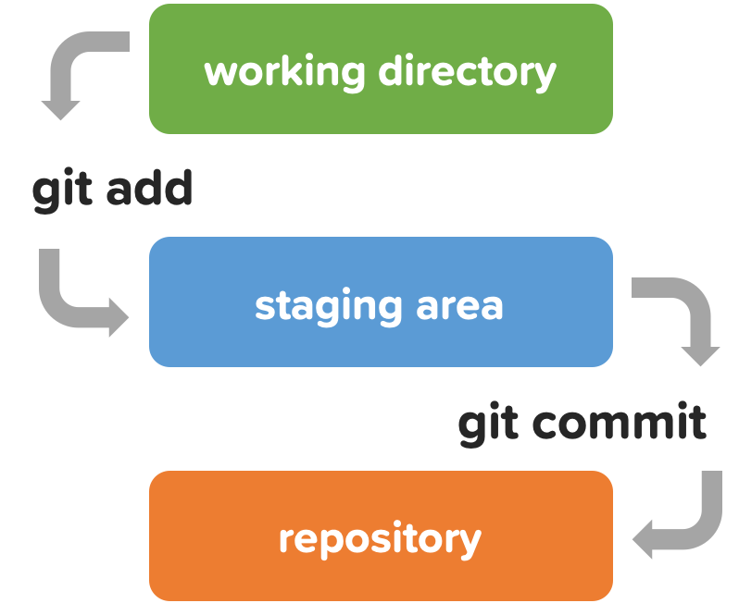
Hands-on B Review
Saving with Git
git remote
git push
Command to manage the connection between the local & remote repos
Command to upload local repo content to a remote repo

Slide 52
Make & Merge Branches!
Hands-on C

Slide 53
Create a New Branch
Branches
$ git checkout -b develop
Switched to a new branch 'develop'
$ git branch
* develop
master
By default, the repository has the master branch
Create a branch named develop
git checkout -b <branch name>
command to create a new branch & switch to it
git branch
command to view a list of branches
current branch has the asterisk (*)

Slide 54
Changing develop Branch
Branches
$ touch develop_file.md
$ git add develop_file.md
$ git commit -m "develop only"
[develop f946eb0] File only in develop branch
1 file changed, 0 insertions(+), 0 deletions(-)
create mode 100644 develop_file.md
$ git status
On branch develop
nothing to commit, working tree clean
$ git push -u origin develop
While being in the develop branch, create a file.
Run git add and git commit to save it to the local repo.
Run git status to confirm the changes.
Run git push to push the changes to GitHub repo

Slide 55
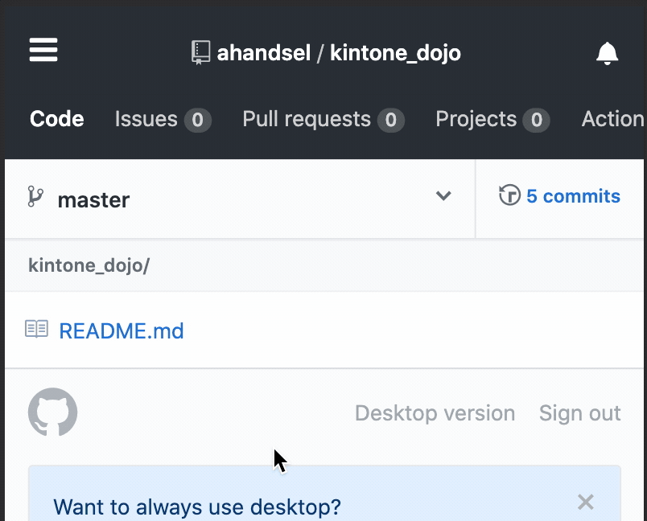
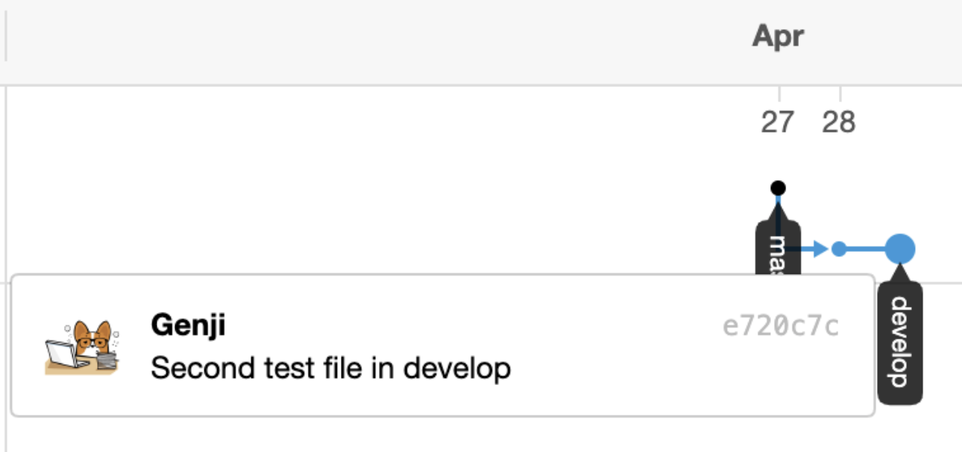
Confirming the Change on GitHub
Branches
Only the develop branch included the new file
Add another file in develop branch
Then view the Network graph
https://github.com/USER/REPO/network

Slide 56
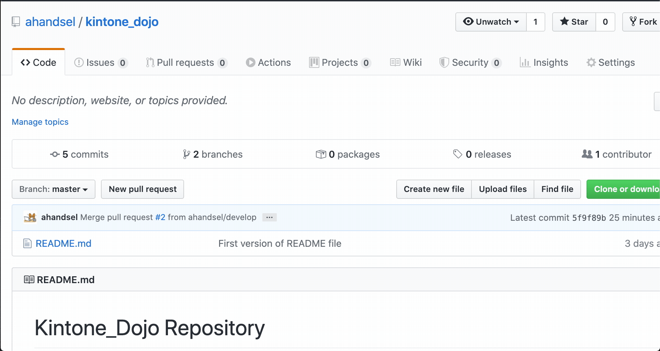
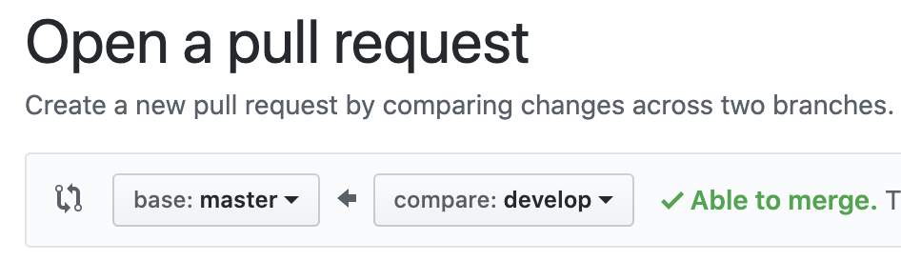
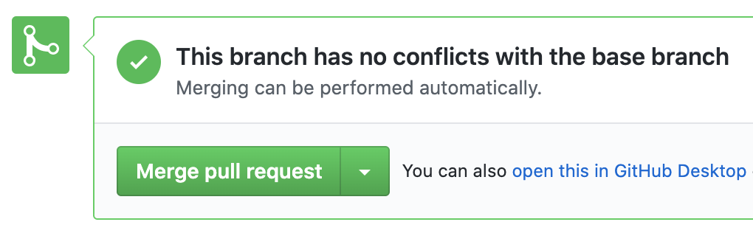
Create & Merge Pull Request
Branches
Pull Requests shows others your changes without actual modifying
useful for code review
On GitHub, create the pull request to merge develop -> master branch
Confirm the changes and Merge Pull request
This results in master branch having the two new files!

Slide 57
GitHub repo → Update Local repo
Branches
$ git checkout master
Switched to branch 'master'
Your branch is behind 'origin/master' by 4 commits & can be fast-forwarded
(use "git pull" to update your local branch)
$ git pull origin master
remote: Enumerating objects: 1, done.
remote: Counting objects: 100% (1/1), done.
remote: Total 1 (delta 0), reused 0 (delta 0), pack-reused 0
Unpacking objects: 100% (1/1), 631 bytes | 210.00 KiB/s, done.
From https://github.com/ahandsel/kintone_dojo
* branch master -> FETCH_HEAD
5f9f89b..1438ca5 master -> origin/master
Updating d775d42..1438ca5
Fast-forward
2nd_file.md | 0
develop_file.md | 0
2 files changed, 0 insertions(+), 0 deletions(-)
create mode 100644 2nd_file.md
create mode 100644 develop_file.md
$ git branch -d develop
Deleted branch develop (was c6e6c83).
$ git branch
* master
$ git checkout master
$ git pull origin master
$ git branch -d develop
$ git branch
Currently, your GitHub repo is ahead of the local copy
Use git pull command to address this
git pull origin master
pull the latest repo version from GitHub to the local repo

Slide 58
What are branches?
Overview of Hands-on C

Slide 59
Git Branches
Branches
What are branches?
Why use branches?
movable pointer to a commit
mechanism that manages multiple timelines, allowing for changes without impacting the main line
git checkout
command to switch branches
git branch -d <branch-name>
command to delete branches
allows for a separation between stable, in-development, and experimental changes
Example: This GitHub Slides
Each Hands-on and concept section can be a branch.
Each can be developed in parallel.
Notes:
https://git-scm.com/book/en/v2/Git-Branching-Branches-in-a-Nutshell

Slide 60
Branches - Website
Branches
master branch contains the 'live' code that runs the website.
changes in master impacts users
Two coders want to modify the website at the same time. Make 3x branches:
master → live code
feature_A → for coder A to modify
feature_B → for coder B to modify
Once the code developments are done, merge the branches.

Slide 61
Git Pull vs Push
Git Pull vs Push
git push
git pull
the 'upload' command
"Push" is forcing the changes to the target repo.
[ your code ] -- pushing --> [target]
A "push request" would be the target repo requesting you to push your changes.
the 'download' command
"Pull" is the target repo grabbing your changes
[ your code] }-- pulling -- [target]
A "pull request" is you requesting the target repository to please grab your changes.

Slide 62
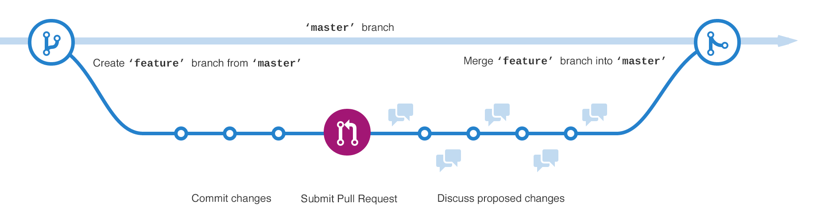
GitHub Workflow

Slide 63
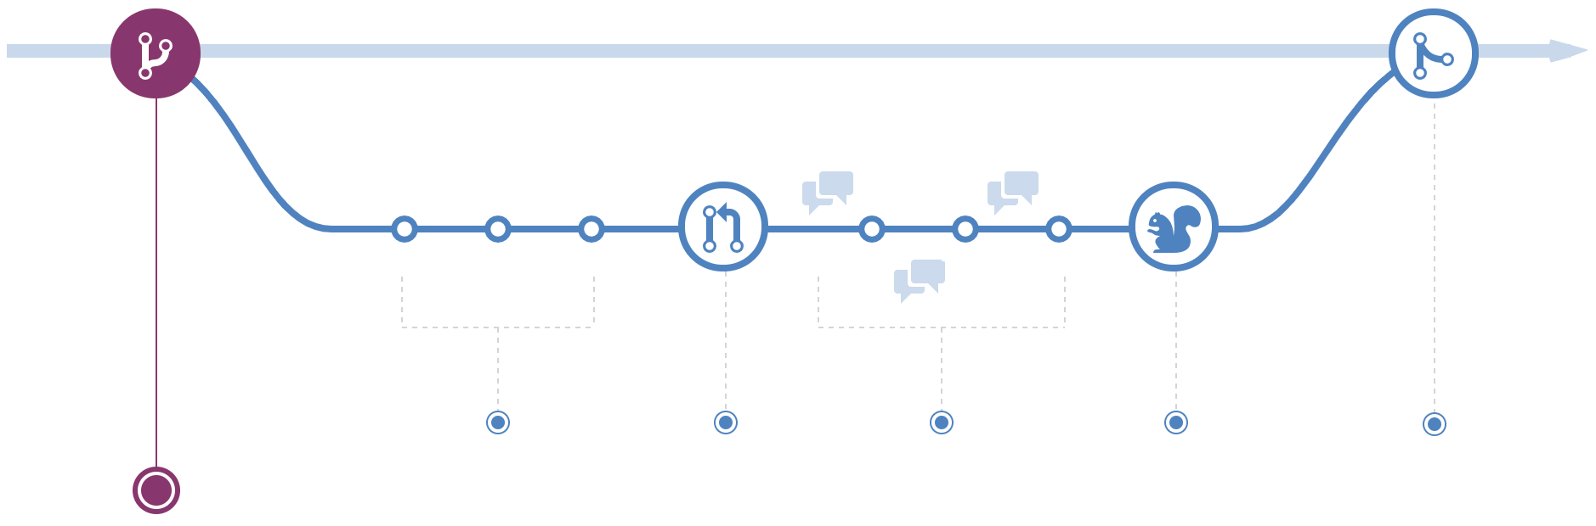
#1 - Create a Branch
GitHub Workflow
$ git checkout -b develop
$ git branch
The code for the live website is in the master branch
Any changes to here will effect the users!
If you want to create a new page, first create a new feature branch.
This is where you will do the development for the new page.
https://guides.github.com/introduction/flow/

Slide 64
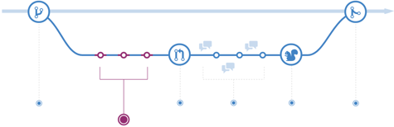
#2 - Making a commit
GitHub Workflow
In your feature branch, you are modifying code.
Each time you want to save a change, make a commit.
This keeps track of changes and provides a transparent history.
Commits allow for roll backs and references.

Slide 65
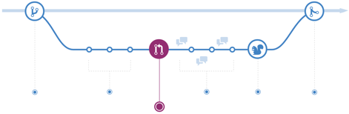
#3 - Open a Pull Request
GitHub Workflow
When you are ready to share your changes to others, open a Pull Request.
Pull Requests are the start of code review.
Make & review comments at the Pull Request tab on GitHub.

Slide 66
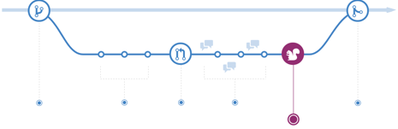
GitHub Workflow - Test
GitHub Workflow
After code review, deploy your code to make sure everything works.
Example: Test if the website looks and acts as expected.

Slide 67
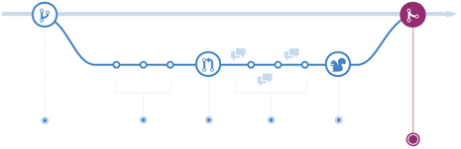
GitHub Workflow - Merge to Master!
GitHub Workflow
Merge your code into the master branch.
Now your changes are live & effects the users.
Once merged, Pull Requests acts as reference points.

Slide 68
GitHub Workflow - Overview
GitHub Workflow
https://commonflow.org/spec/1.0.0-rc.5.html

Slide 69
Revert:
Rewind the Clock
Hands-on D

Slide 70
Preparation for Time Travel
Revert
$ git checkout master
$ git checkout -b timeline
$ touch yr_1.md
$ git add yr_1.md
$ git commit -m "Year 1"
$ …
Create a branch timeline
Create and commit changes three times.
yr_1.md yr_2.md yr_3.md

Slide 71
Check the Past
Revert
$ ls
README.md yr_1.md. yr_2.md. yr_3.md
$ git log --oneline
489ca71 (HEAD -> timeline) Year 3
7470790 Year 2
444b696 Year 1
8766df2 (origin/master, master) …
$ git checkout 444b696
$ ls
README.md yr_1.md.
git log --oneline
Lists out the commits of the branch
Use the commit hash provided for checkout and revert commands
git checkout [commit hash]
Convert the working directory to be the exact state as the [commit].
Check if this is the commit you want to revert back to.
No changes made in this situation will be saved.

Slide 72
Time Travel Back 2 Commits
Revert
$ git checkout timeline
Switched to branch 'timeline'
$ git revert HEAD~2..HEAD
Removing yr_3.md
Removing yr_2.md
$ git log --oneline
d4f441f (HEAD -> timeline) Revert "Year 2"
843f802 Revert "Year 3"
489ca71 Year 3
7470790 Year 2
444b696 Year 1
8766df2 (origin/master, master) …
git revert [commit hash]
Forward-moving undo command
It inverts the changes made by the specified [commit] and appends the result as a new commit.
git revert HEAD
Goes back by 1 commit
git revert HEAD~[#]...HEAD
Goes back by [#] commits

Slide 73
Reset vs Revert
Revert
git reset [commit]
git revert [commit]
Past-deleting undo operation
Goes back to the past [commit] and removes all commits between now till then.
This cleans up everything.
However, the history of the deleted commits are lost.
Forward-moving undo operation
Creates a new commit with the past [commit].
No commits are deleted.
Use for a public/ shared repos
Past [Commit]

Slide 74
GitHub
Website Overview

Slide 75
GitHub Repository
GitHub Overview
GitHub Repository - Code
Container that holds everything related to the project like code and documentation.
All files stored here are managed with git version control
Repository is often shorted to 'repo'
README.md
File that introduces the project and is displayed in repository's bottom.

Slide 76
GitHub Issues & Pull Request
GitHub Overview
Issues
Where users discuss about the code
Issues can be assigned to users and add label for easy reading
Pull request
represents change that a user wants to make to the repository
Example: Bob creates a Pull request to add the new README.md file.

Slide 77



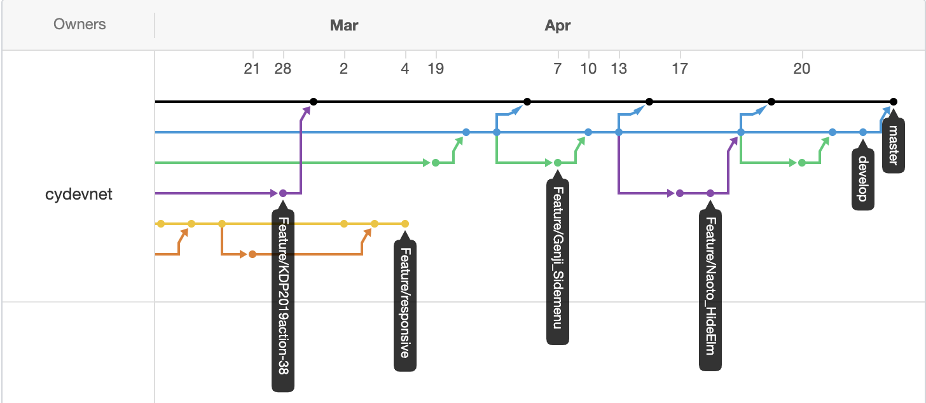
GitHub Overview
GitHub Overview
Project boards: Kanban-style task tracking board
Wiki: Create & store relevant project documentation
Insights: Analytics tools for your repository including:
Network Graph: Timeline visualization of the commits & branches
Pulse: View completed & . in-progress tasks

Slide 78
Parts of GitHub
GitHub Overview
Branch
Alternative timeline of the code
Ex: Master, Develop, Feature/xxx
Commit
Saving the file changes to the repo
Pull Request
Share the changes you are proposing with other
Merge Pull Request
Actually updating the Branch (like Master) with the changes,

Slide 79
Git Command-Line Cheat Sheet

Slide 80
Create a Repository
Git Command Line
Command | Description
git init | Initialize a local Git repository
git clone [url] | Clone (download) a repo from GitHub
git remote add origin [url] | Link a local repo to a remote repo
Example URL = https://github.com/user/repo
Notes:
https://github.github.com/training-kit/downloads/github-git-cheat-sheet/

Slide 81
Branches
Git Command Line
Command | Description
git status -v | see which branch is the current one
git branch [branch-name] | Create a new branch
git branch -d [branch] | Delete the specified branch
git checkout [branch] | switch the working directory
git merge [branch] | Merges the specified branch's history into the current branch.
Notes:
https://github.github.com/training-kit/downloads/github-git-cheat-sheet/

Slide 82
Sync Changes Between Local & Remote
Git Command Line
Command | Description
git fetch [remote] [branch] | Download history from the remote branch
git push [remote] [branch] | uploads the specified branch to [remote]
git pull [remote] | fetch & download content from [remote]

Slide 83
Snapshotting
Git Command Line
Command | Description
git add [file] | adds [file] to staging area
git status | Checks file status
git add -A | Add all new & modified files to the staging area
git commit -m "[message]" | Commit changes with a message
git rm -r [file] | Remove a file or directory

Slide 84
Make Changes
Git Command Line
Command | Description
git log | lists version history of the current branch
git log --follow [file] | version history specific to [file]
git diff [branch A] [branch B] | Shows the difference between the branches
git show [commit] | view details on the [commit]

Slide 85
Redo Commits
Git Command Line
Command | Description
git reset [commit] | revert back to [commit] Past-deleting undo operation
git revert [commit] | 'safe' way to revert back to [commit] Forward-moving undo operation
git revert HEAD | Create a new commit with the inverse of the last commit

Slide 86
Appendix

Slide 87
Window Specific Tutorials
Windows
https://www.datacamp.com/community/tutorials/git-push-pull

Slide 88
Resources
https://product.hubspot.com/blog/git-and-github-tutorial-for-beginners
https://guides.github.com/activities/hello-world/

Slide 89
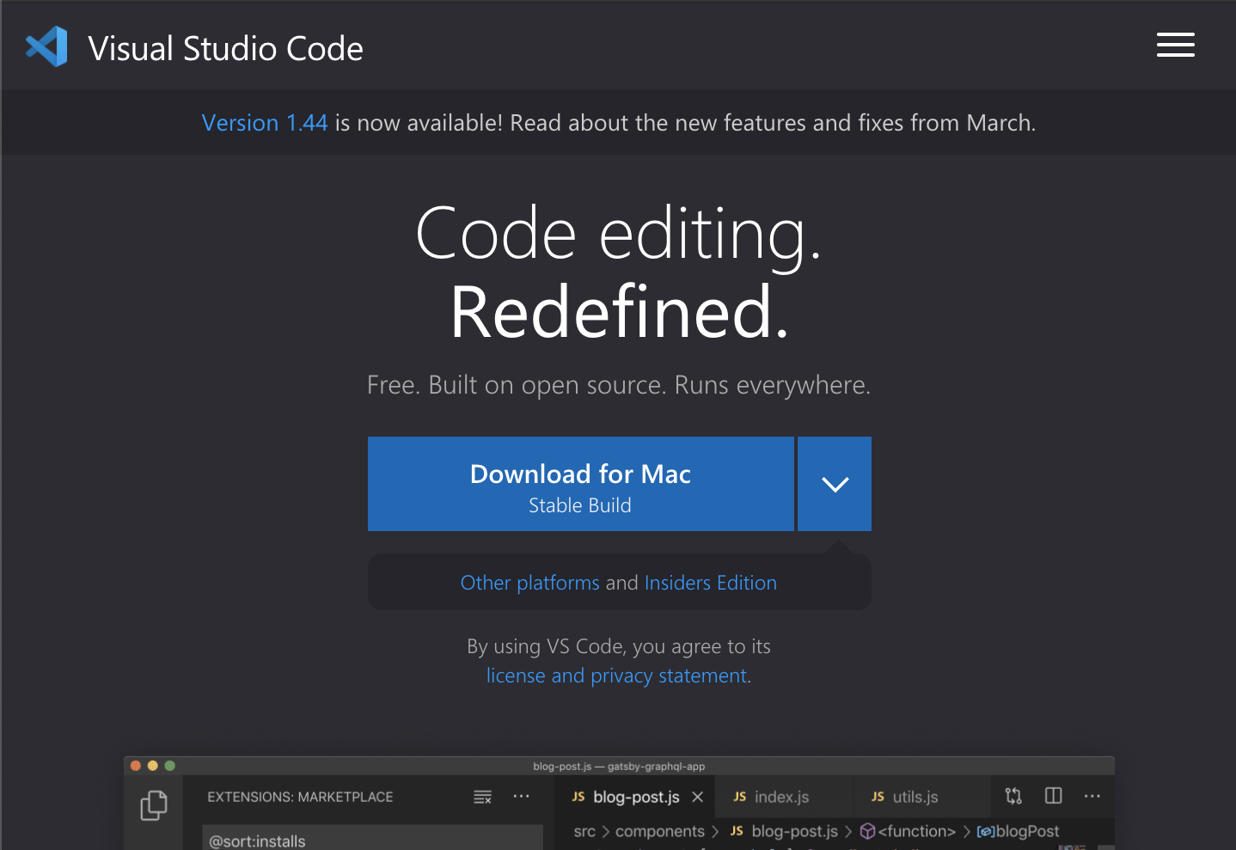
Visual Studio Code + Command Line
VS Code
Download Visual Studio Code:
code.visualstudio.com
Run VS Code from Command Line
Open VS Code
Open Command Palette
by pressing Command + Shift + P
Then type Shell & select Shell Command : Install code in PATH
Restart the terminal
Open VS Code in current directory by typing Code .

Slide 90
Recommend Plugins for VS Code
VS Code
Auto Close Tag
Auto Rename Tag
Beautify
Bracket Pair Colorizer
Material Theme
ES Lint
Highlight Matching Tag
HTML Snippets
Live Server
Material Icon Theme
nbsp-vscode
Replace curly quotes
Settings Sync
zenkaku

